Slide 1
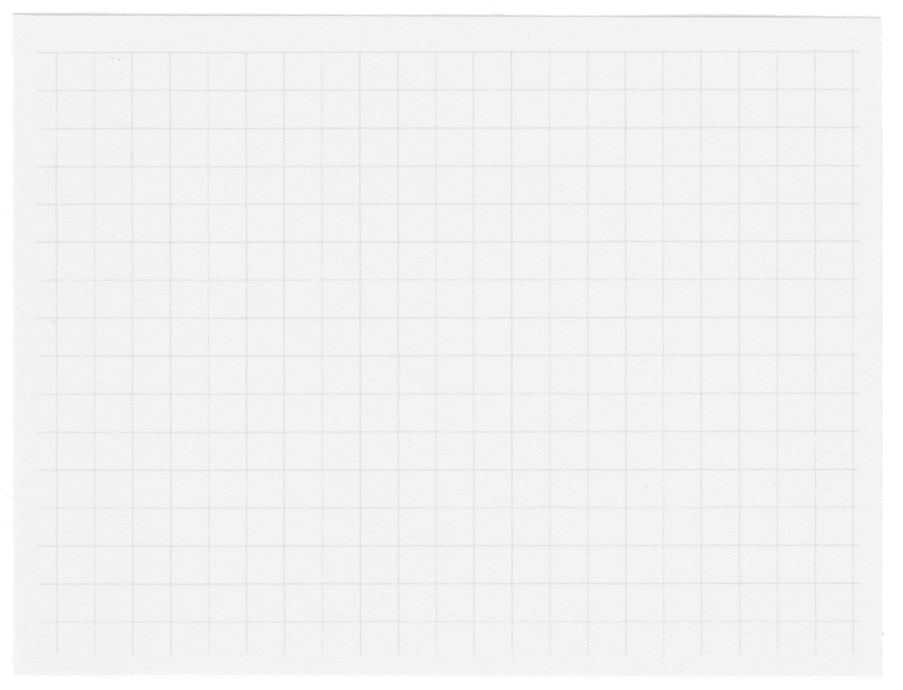












Classification of
Mental Health
Presented by Fahimul Alam

Slide 2

Objectives
To analyze a dataset of mental health surveys to understand the factors influencing mental well-being
To build a predictive model for classifying mental health status based on survey responses

Slide 3
Created a 'Mental Health Status' target variable based on sleep, exercise, and social interaction
01.
Data Preprocessing
Imputation using mean for numerical and mode for categorical data and encoded this categorical feature into numerical values.
02.
03.
Checked for and handled missing values by various methods

Slide 4
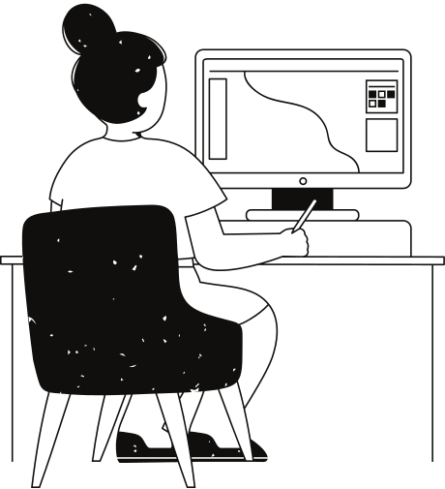
EDA
A noticeable concentration stress level is between 4-7 level.
There is a co-relation between Hours of Sleep per night and Stress Level
Age and social interaction is highly corelated
Stress Level is highly co-related with Stress Level and Sleep Hours

Slide 5
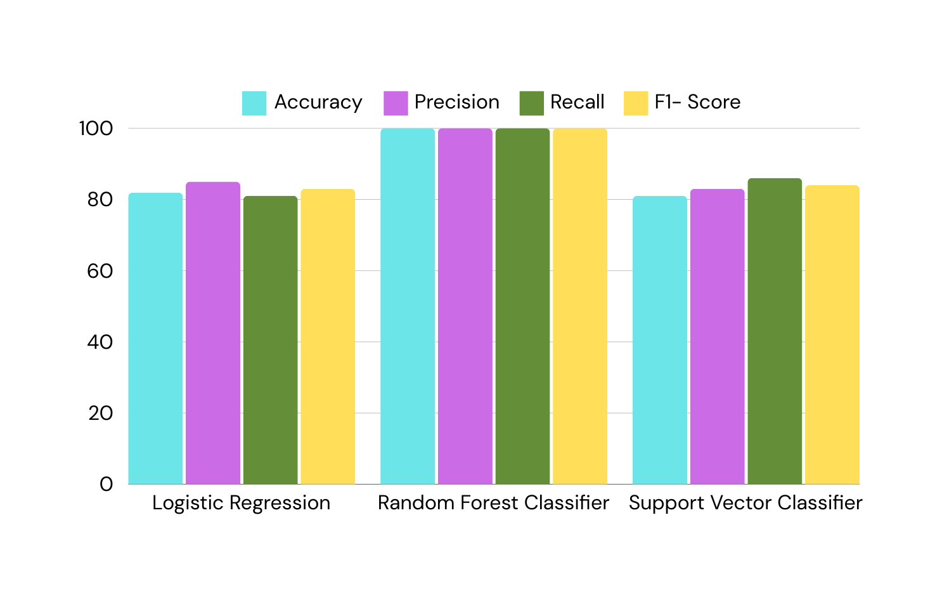
Model Development and Evaluation

Slide 6
Key Takeaways
&
Recommendations
Major Points
Suggestions
Sleep, exercise, and social interaction are important factors for mental health
Random Forest model has signs of overfitting
Modularize the system
Explore non-linear models
Collect more data

Slide 7
Thank you very much!

